Slide 1
Casual vs Member

Slide 2
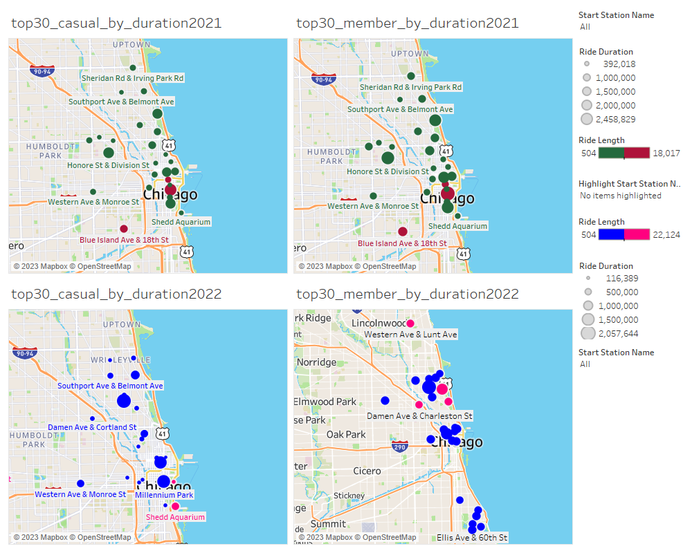

Slide 3
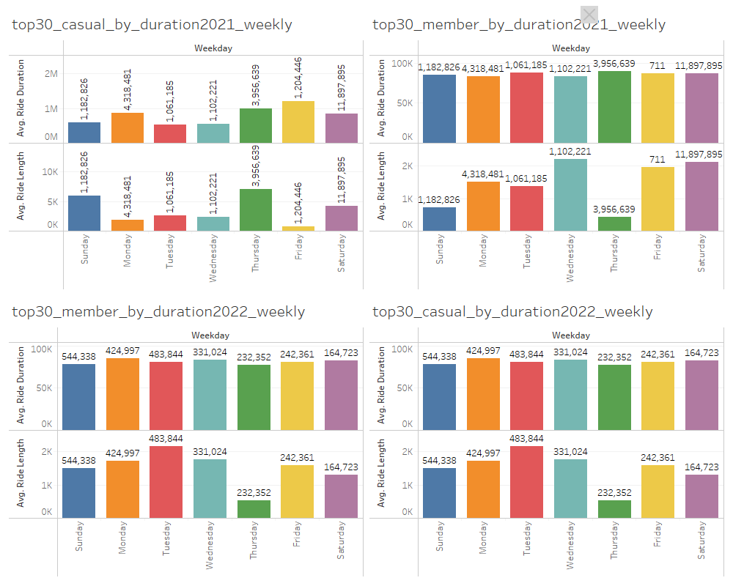
top30_member_by_duration2021_weekly

Slide 4
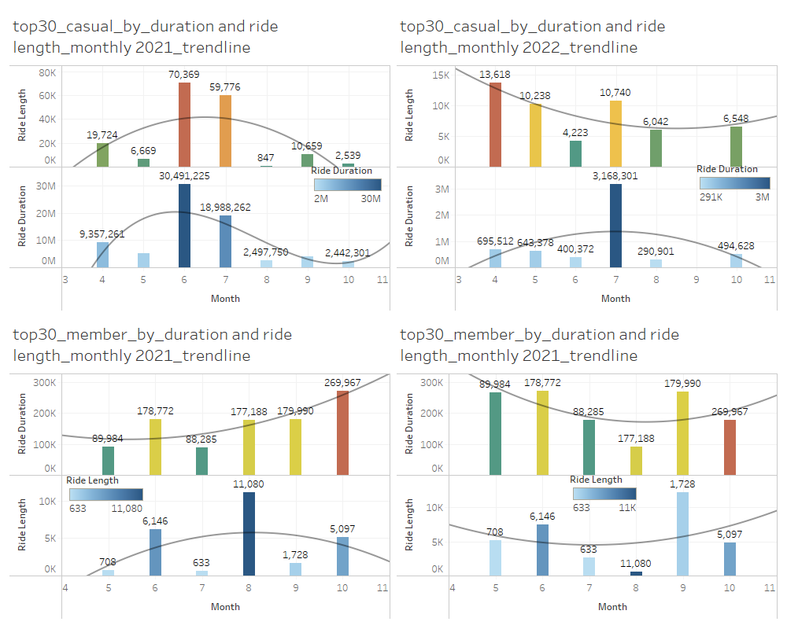

Slide 5
